Slide 1
Plan, Design, Develop, and Test Report Application
Module Project
Module: NICF-Application Implementation (SF)
Course: Design, develop and test the Community portal website
Start Date : 21-08-2022
End Date : 23-08-2022
Submission Date : 23-08-2022
Learner Name : Viddy Virstandi P.A.P
Enrollment ID : BDSE04-0322
Presentation Date :

Slide 2
Contents
Document History
Version Number | Effective Date of release | Summary of Included Changes | Author
1 | 4th March 2016 | First Edition | Satya CVS
2 | 23rd Jul 2018 | Changed for Module 6 | Shrinivas K R

Slide 3
Contents
Contents
S. No. | Description
01 | Different Types of Testing
02 | How Different Testing Helps
03 | Tests Selected
04 | Test Schedule
05 | Test Results
06 | Testing Tools
07 | Project Milestone & Tasks
08 | Milestone Feedback & Action Taken
09 | Modifications Made Based on Feedback
10 | Project Results
11 | Proposed Improvements

Slide 4
1. Different Types of Testing
List types of Testing
Unit Tests
Unit tests are very low level and close to the source of an application. They consist in testing individual methods and functions of the classes, components, or modules used by your software
Integration Tests
Integration tests verify that different modules or services used by your application work well together.
Functional Tests
Functional tests focus on the business requirements of an application. They only verify the output of an action and do not check the intermediate states of the system when performing that action.
End-to-end Tests
End-to-end testing replicates a user behavior with the software in a complete application environment.
Acceptance Tests
Acceptance tests are formal tests that verify if a system satisfies business requirements.
Performance Tests
Performance tests evaluate how a system performs under a particular workload

Slide 5
2. How Different Test Helps
Unit Testing
helps developer write better code.
helps developer catch bugs earlier.
helps developer detect regression bugs.
Integration Testing
It effectively executes important user-based scenarios.
It might uncover adhoc tests you hadn't thought of earlier.
It ensures that internal modules and components communicate properly.
Functional Testing
It ensures that the customer or end-user is satisfied.
It produces a defect-free product/software.
It ensures the all the requirements should be met.

Slide 6
3. Tests Selected
List the testing methods selected to test the project
Unit Testing
A software development process in which the smallest testable parts of an application, called units, are individually and independently scrutinized for proper operation.
UAT Testing
a phase of software development in which the software is tested in the real world by its intended audience.

Slide 7
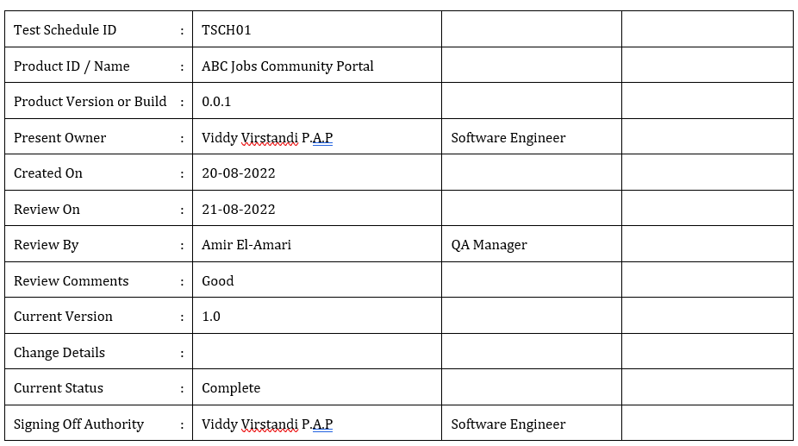
4. Test Schedule
Create an optimal test schedule

Slide 8
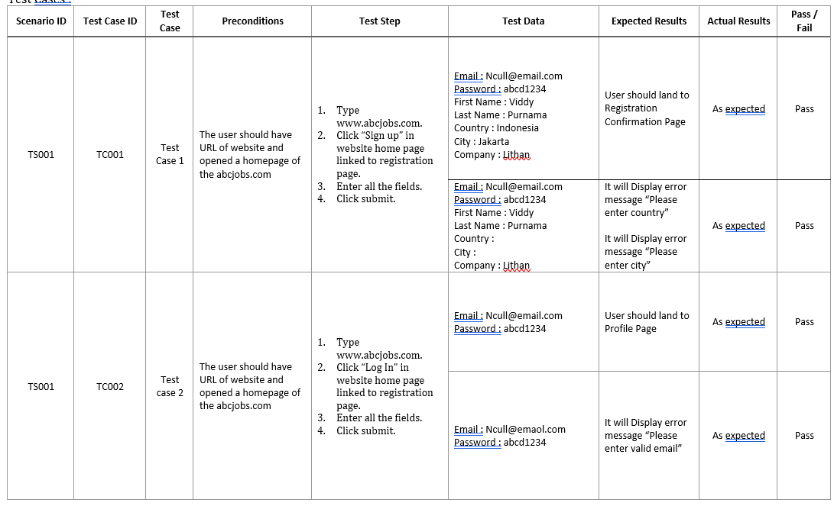
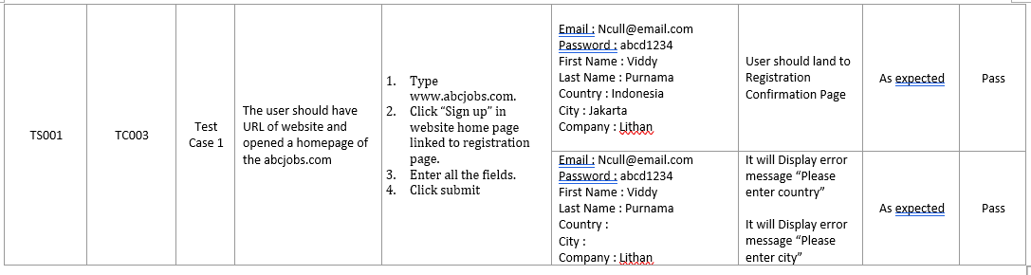
5. Test Results
Give the result of each test along with screen capture

Slide 9
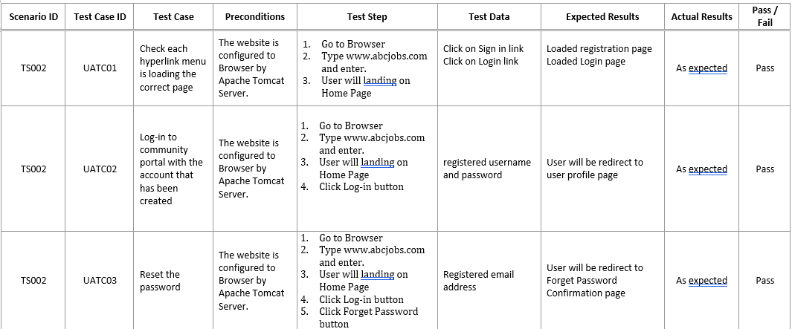
5. Test Results
Give the result of each test along with screen capture

Slide 10
6. Testing Tools
Testing Tools
o ProjectLibre
o Mc. Word
o Mc. PowerPoint

Slide 11
7. Project Milestones & Tasks
Project Task ID | Project Task Description | Project Milestone ID
1 | Analyze and suggest choice of Test Methods | 1
2 | Schedule the Test Optimally | 1
3 | Develop the Phase Test Plan | 1
5 | Develop Test Cases & Scripts | 2
6 | Execute the Tests & Document the results | 3

Slide 12
8. Milestone Feedback & Action taken
Project Milestone ID | Milestone Feedback received from Tutor / Learning Facilitator | Action Taken (Yes / No)
1
2
3

Slide 13
9. Modifications Made based On Feedback

Slide 14
10. Project Results

Slide 15
10. Project Results

Slide 16
11. Proposed Improvements
List of Improvements
Add more Testing method

